Slide 1

Water Quality Modeling and Contaminant Modeling Processes Team Capabilities
UNCLASSIFIED
Jodi Ryder, PhD, Research Civil Engineer
Todd Steissberg, PhD, PE, Research Environmental Engineer
Environmental Laboratory
Engineer Research and Development Center (ERDC)
U.S. Army Corps of Engineers
Water Quality Workshop, 2025
February 2025
UNCLASSIFIED

Slide 2
Team Members and Contributors (Alphabetical)
Lea Adams, USACE-HEC
Steve Andrews, RMA
Anthony Aufdenkampe, LimnoTech
Sitlaly Avelino, USACE-SPK
Chris Berger, PSU
Tom Brauer, USACE-HEC
Barry Bunch, USACE-ERDC-EL
Haley Canham, USACE-SPK
John DeGeorge, RMA
Chuck Downer, USACE-ERDC-CHL
Samantha Eanes, USACE-SPK
Paul Ely, RMA
Trudy Estes, ERDC-EL
Christine Hoffmann, USACE-SPK
Joan Klipsch, USACE-HEC
John Kucharski, USACE-ERDC-EL
Zach Jelenek, USACE-SPK
Mark Jensen, USACE-HEC
Billy Johnson, LimnoTech
Nancy Lam, USACE-SPK
Shannon Larson, RMA
Cindy Lowney, RMA
Lauren Melendez, USACE-ERDC-GRL
Ryan Miles, RMA
Alexis Mills, USACE-NWD
Isaac Mudge, USACE-MVN
Jennifer Olszewski, USACE-ERDC-EL
Leila Ostadrahimi, USACE-HEC
Steve Piper, RMA
Daniel Rucinski, LimnoTech
Jason Rutyna, LimnoTech
Jodi Ryder, USACE-ERDC-EL
Terra Salamida, USACE-SPK
Alex Sanchez, USACE-HEC
Jonathan Sorunke, USACE-SPK
Tad Slawecki, LimnoTech
Don Smith, RMA
Julia Slaughter, USACE-HEC
John Sourbeer, USACE-LRP
Todd Steissberg, USACE-ERDC-EL
Jordan Thennis, USACE-SPK
Dottie Tillman, USACE-ERDC-EL
Dan Turner, USACE-NWD
Scott Wells, Portland State University
Brian Zettle, USACE-SAM
Kelsey Walak, USACE-SPK
Zhonglong Zhang, Portland State University
DA Fellows / Interns, Past and Present

Slide 3
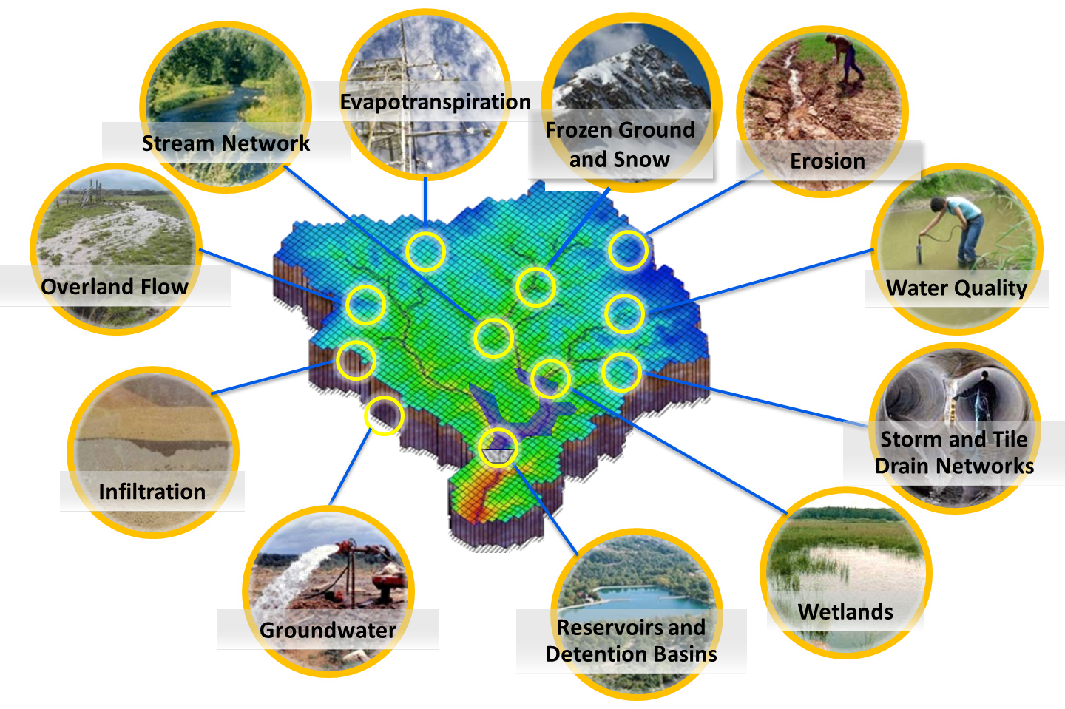
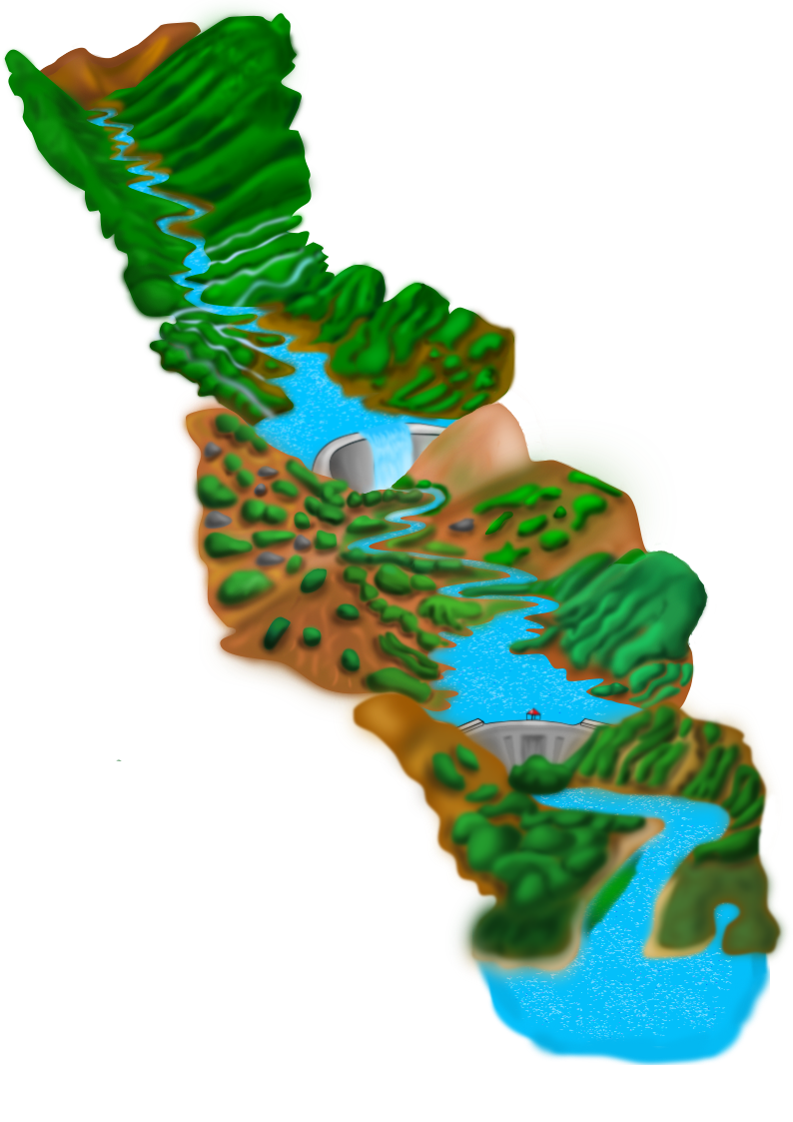
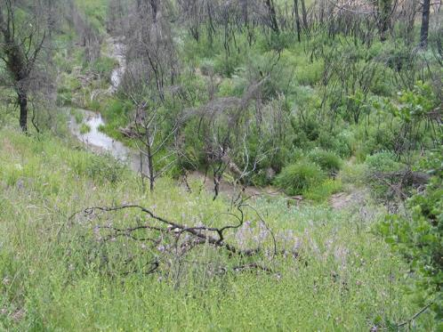
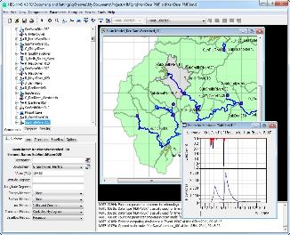
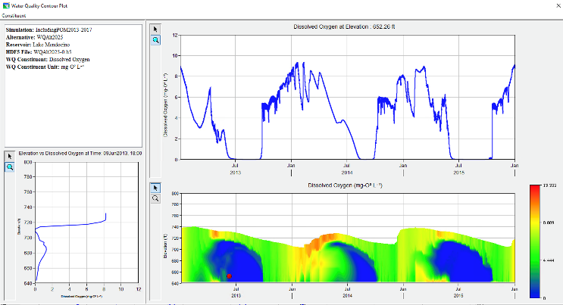
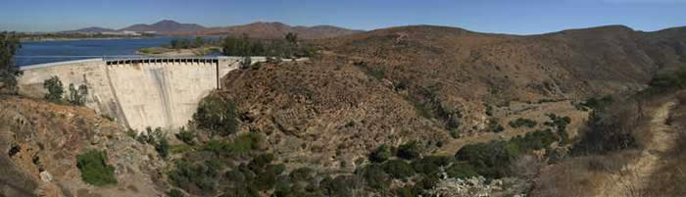
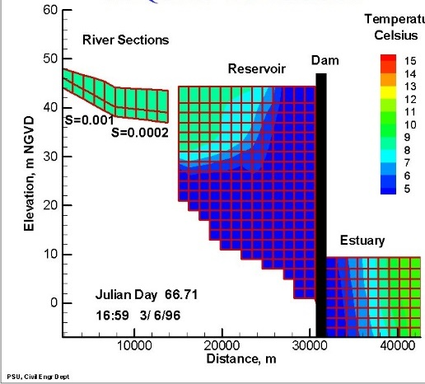
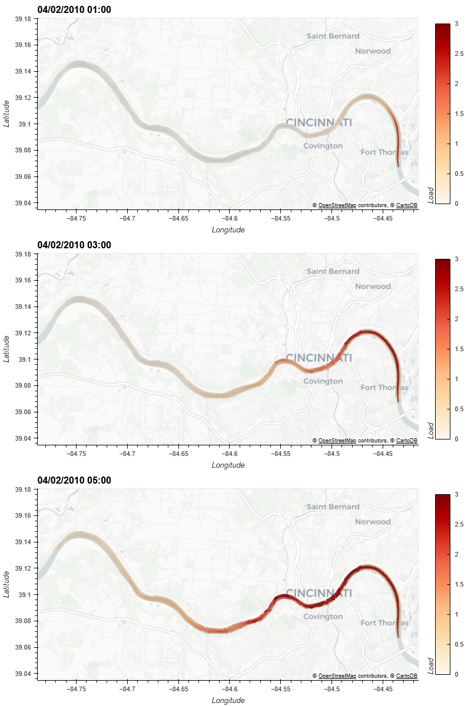
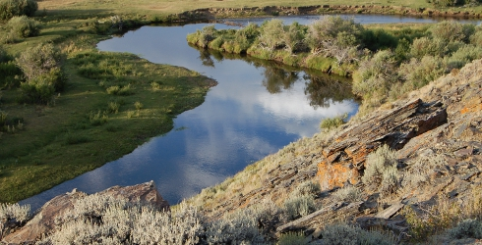
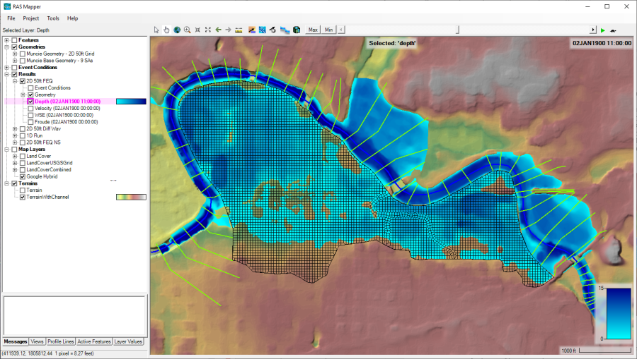
Water Quality and Environmental Systems Modeling
Temperature
Nutrients
Dissolved Oxygen
Algae
Metals
Contaminants
Riparian Vegetation
ERDC’s Corps Library for Environmental Analysis and Restoration of Watersheds (ClearWater) provides environmental simulation capabilities that leverage existing hydrologic and hydraulic (H&H) models.
Water quality modeling tools:
Watershed Runoff:
GSSHA: Surface and sub-surface water quality modeling and Nature-Based Features design tool
HEC-HMS: Surface runoff temperature modeling
Reservoirs:
CE-QUAL-W2: 2D reservoir-river hydrodynamics and water quality modeling
HEC-ResSim: Reservoir operations and water quality modeling
Rivers and Floodplains:
HEC-RAS: 1D River hydraulics and water quality & vegetation modeling
ClearWater-Riverine: 2D River-floodplain hydraulics and water quality modeling with HEC-RAS-2D
Estuary
Key:
ERDC
HEC

Slide 4



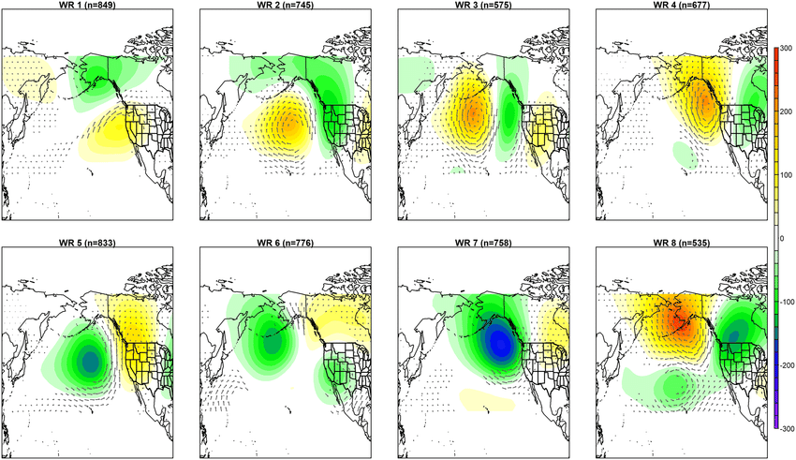
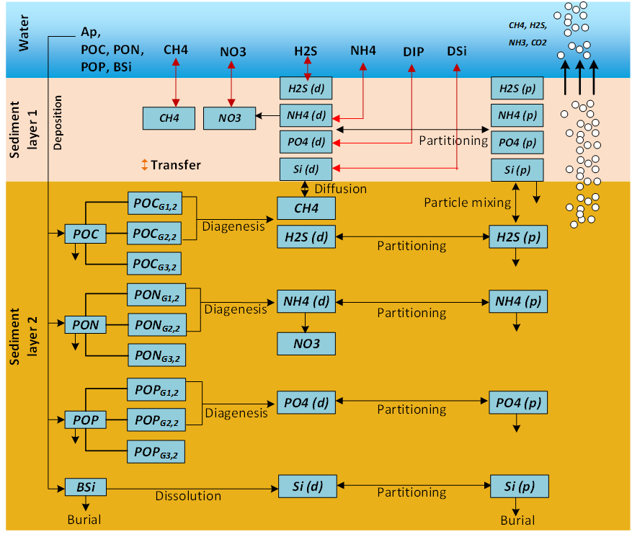
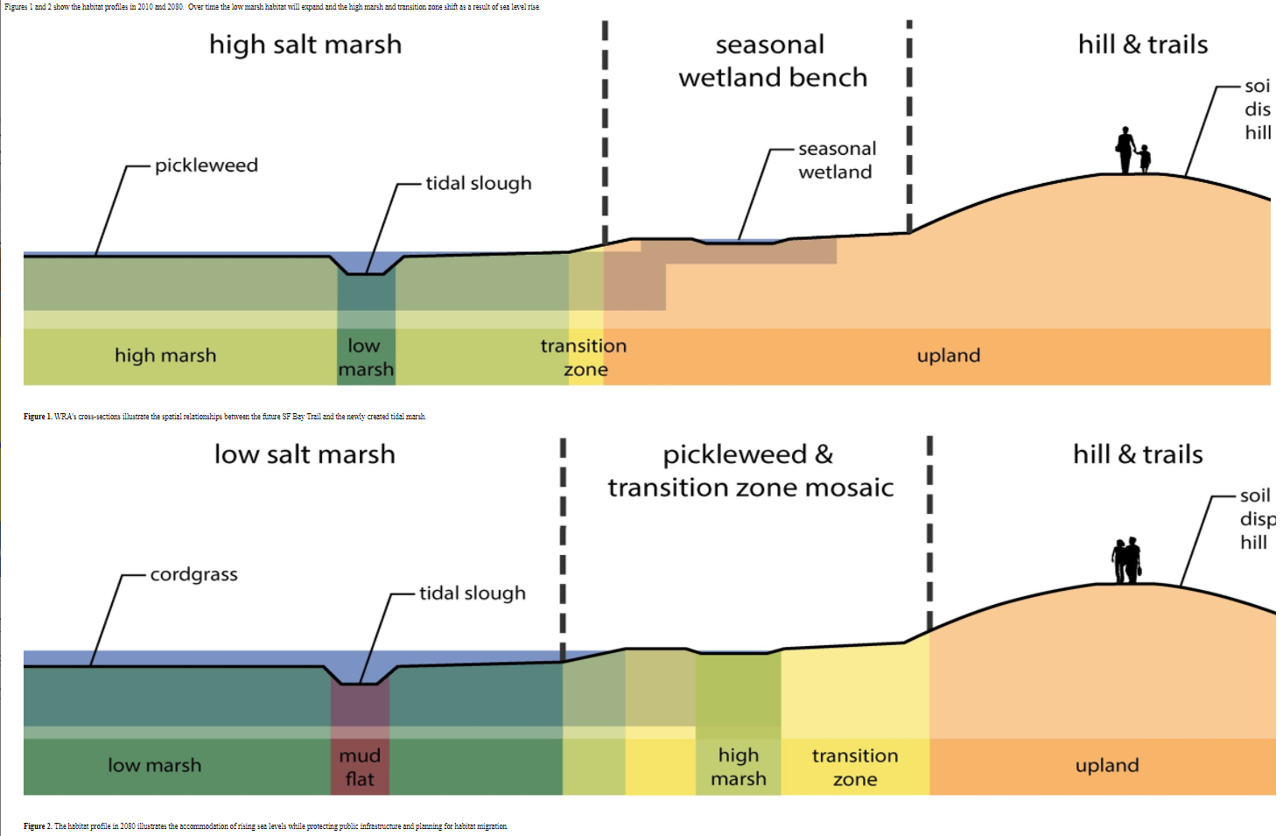
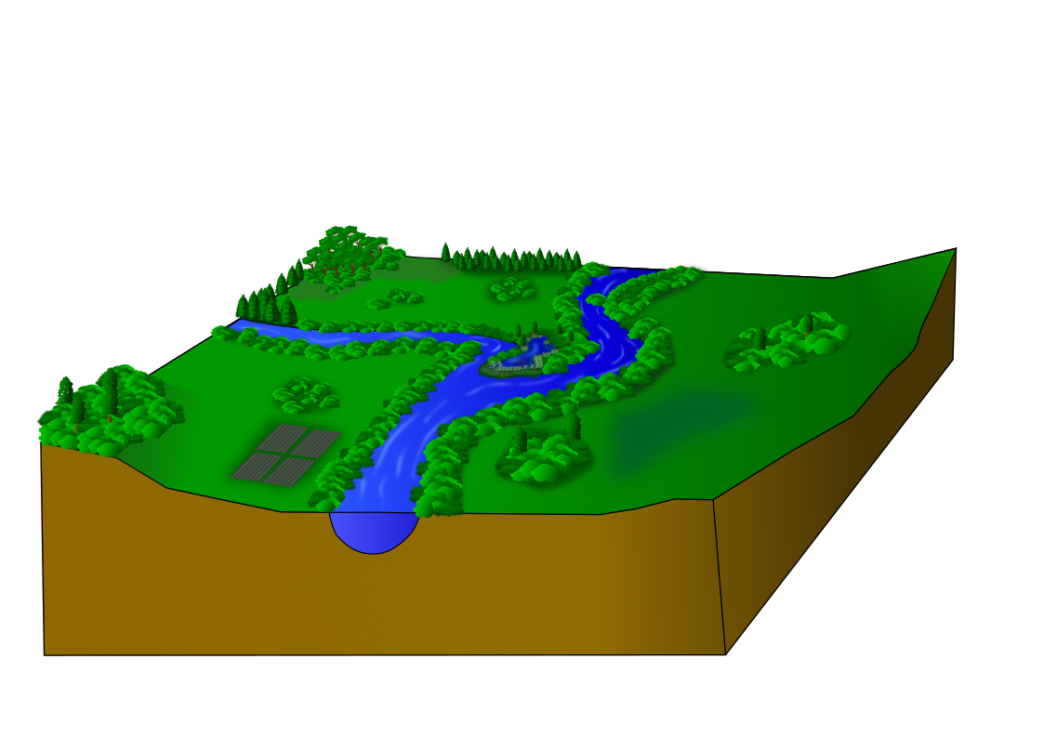
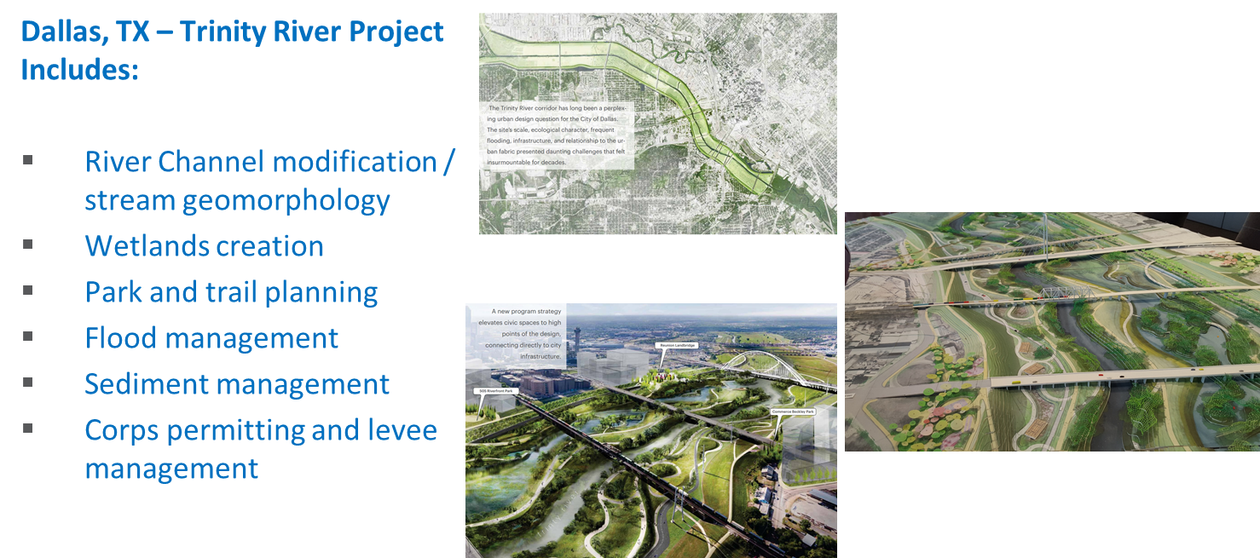
Integrated Environmental Systems Modeling
Developing integrated ecohydrology models that simulate nutrient flow through ecosystems. These models simulate the complex and dynamics interactions between hydrology, meteorology, climate, water quality (salinity, temperature, nutrients), soil chemistry, vegetation, and morphology processes.
Models will enable evaluating infrastructure and operations vulnerabilities and identifying adaptation pathways to improve the resilience of inland and coastal ecosystems to environmental stresses, such as increasing frequency and intensity of extreme precipitation events and droughts, rising sea levels, decreasing freshwater flows, and increased salinity intrusion.
Models will facilitate incorporation of Natural and Nature-based Features (NNBF) in project design and evaluation for improved Engineering with Nature (EWN) solutions.
Environmental Forcing Models
Water Quality Models
Ecological Models

Slide 5
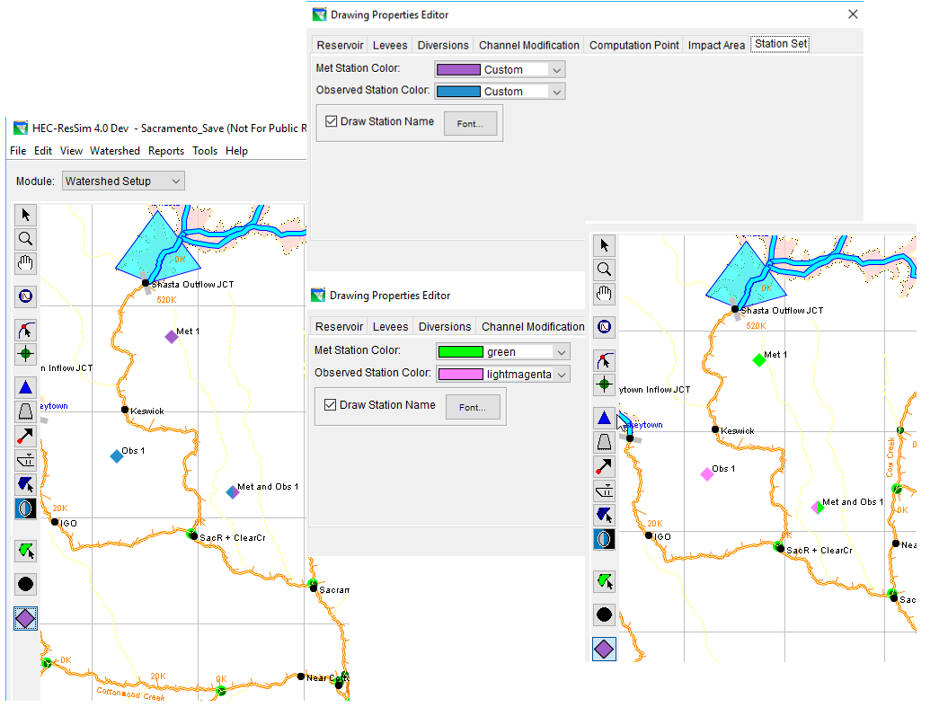
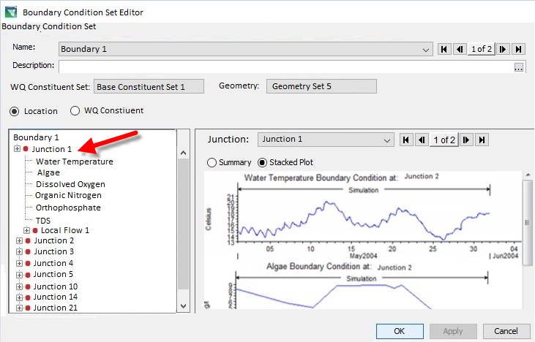
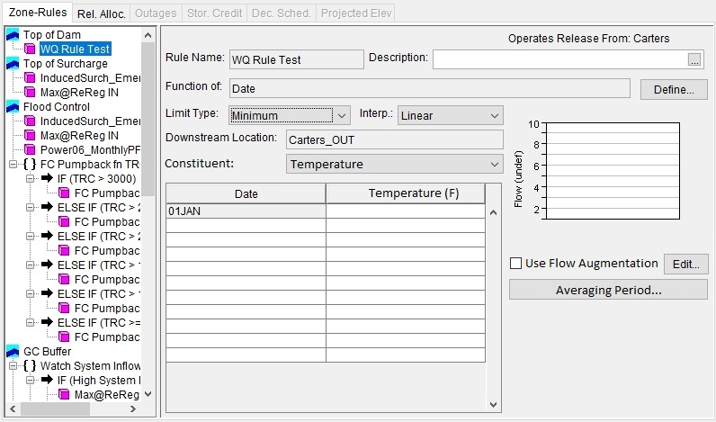
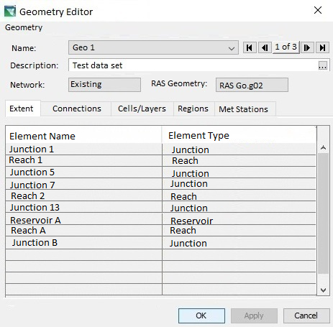
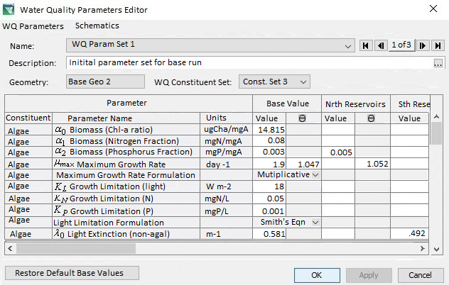
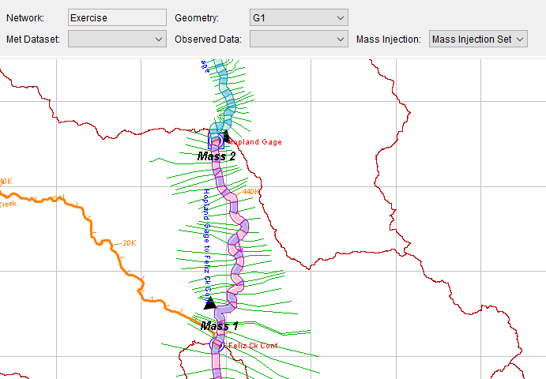
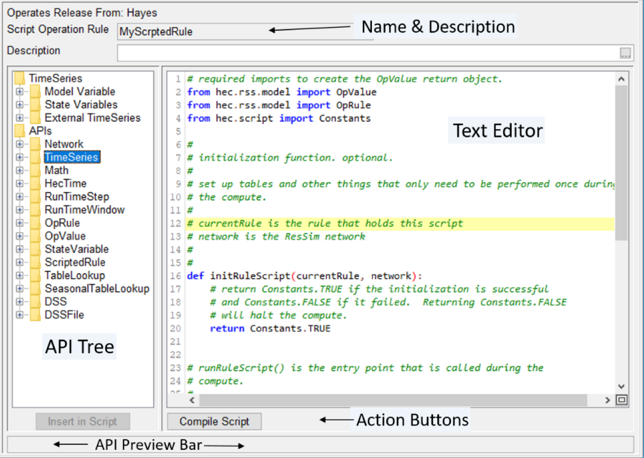
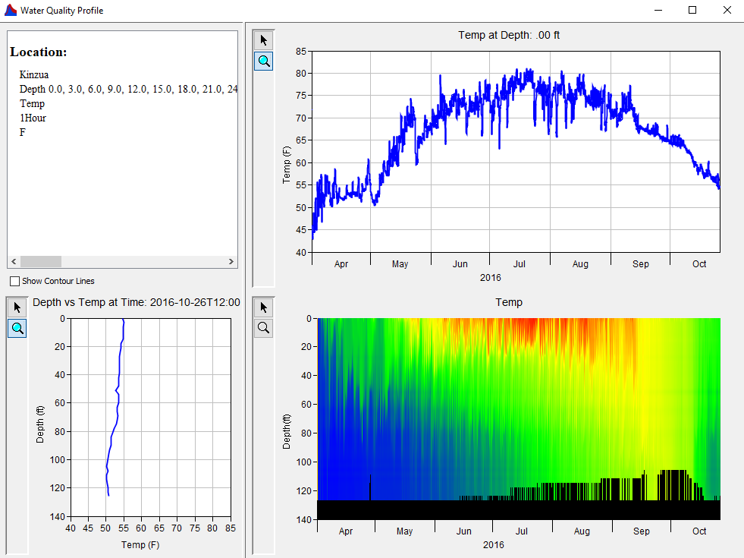
HEC-ResSim Water Quality Model
Model Geometry
Specifying Boundary Conditions
Operating Rule Priorities
Constituent Relation Parameters
Visualization
Scripted Rules and State Variables

Slide 6
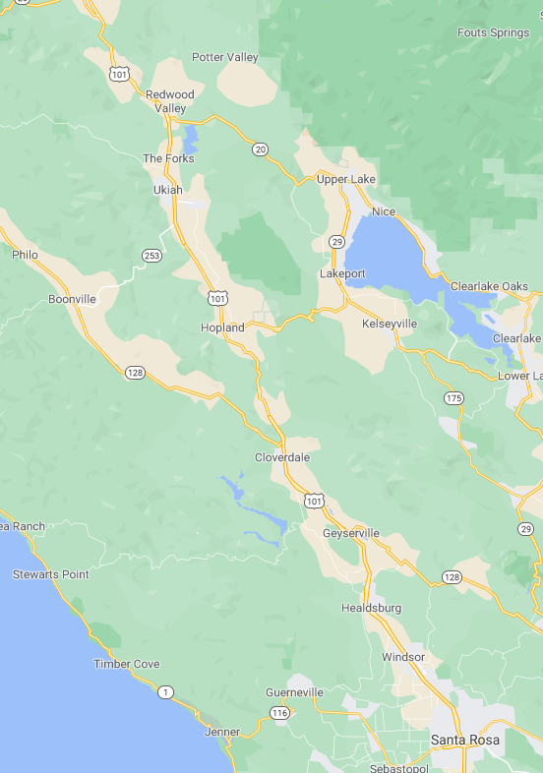
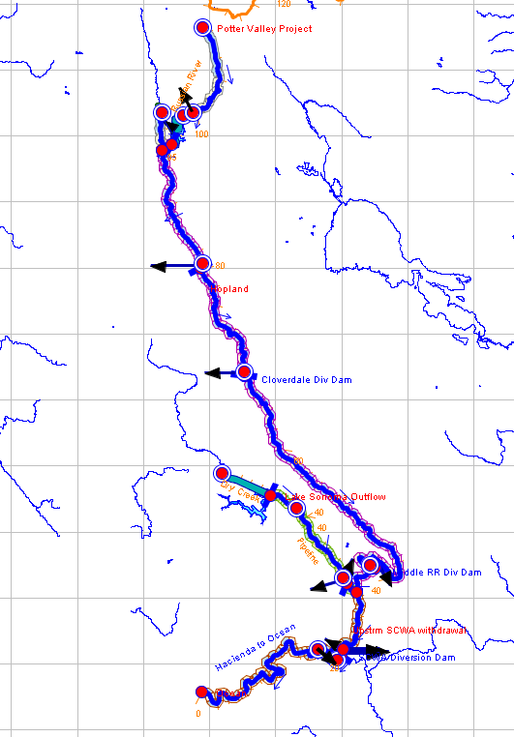
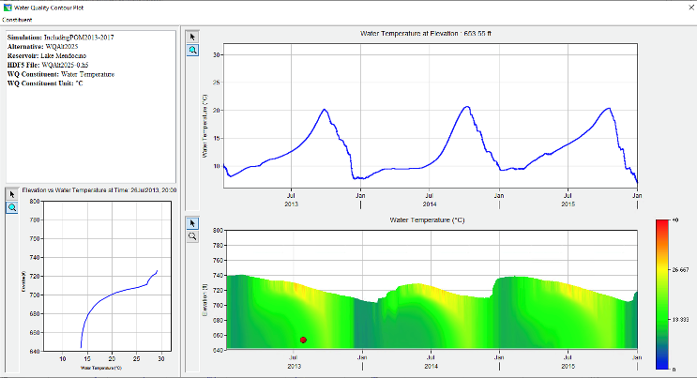
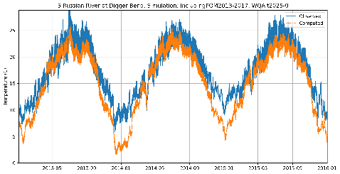
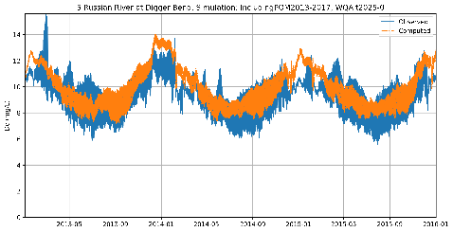
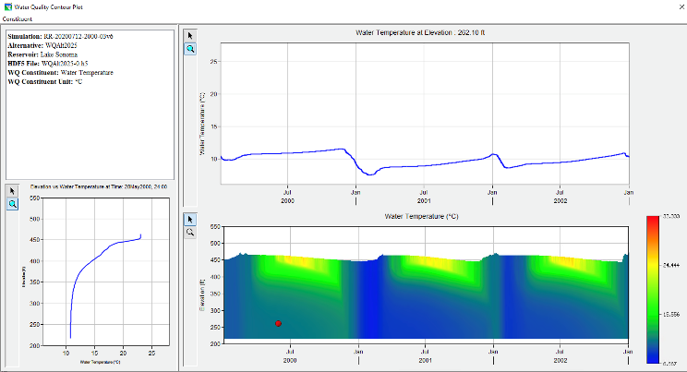
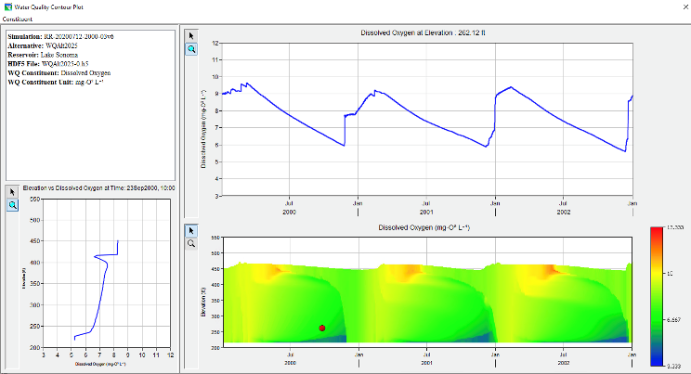
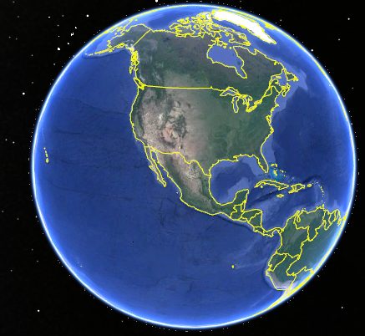
Temperature and Dissolved Oxygen Simulation with HEC-ResSim Russian River, California Prepared by RMA for the Sonoma County Water Agency
Temperature
Dissolved Oxygen
Lake Mendocino
Temperature
Dissolved Oxygen
Lake Sonoma

Slide 7
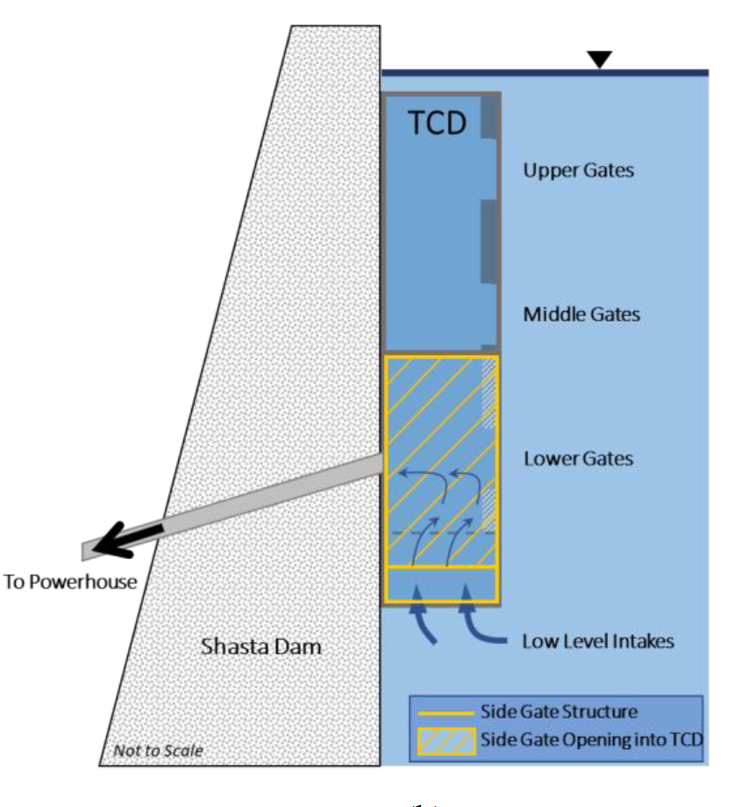
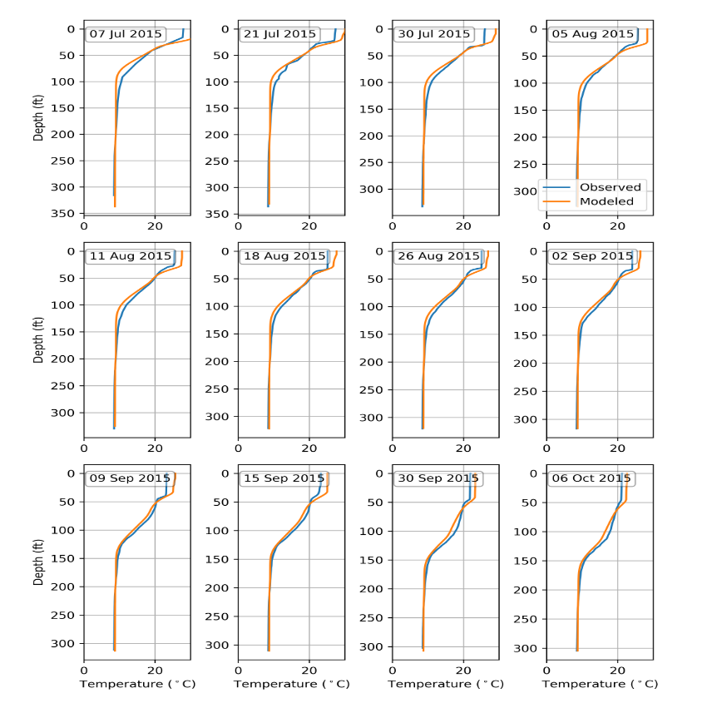
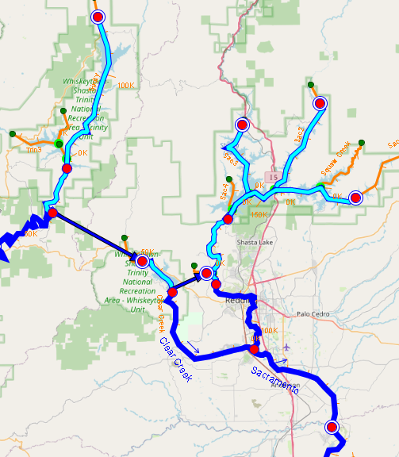
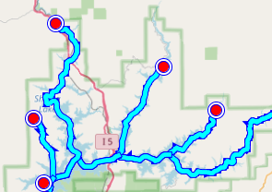
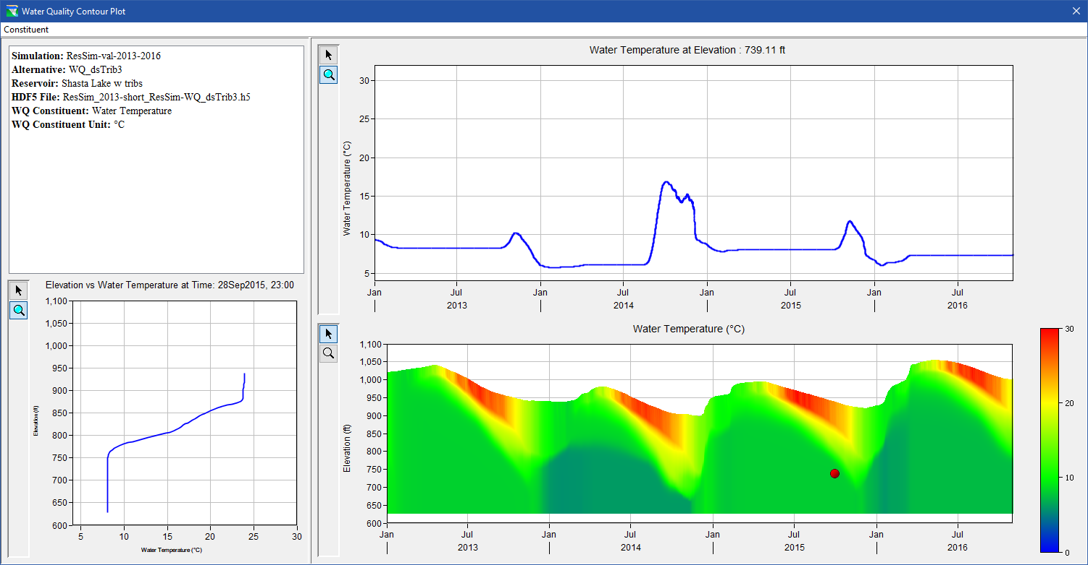
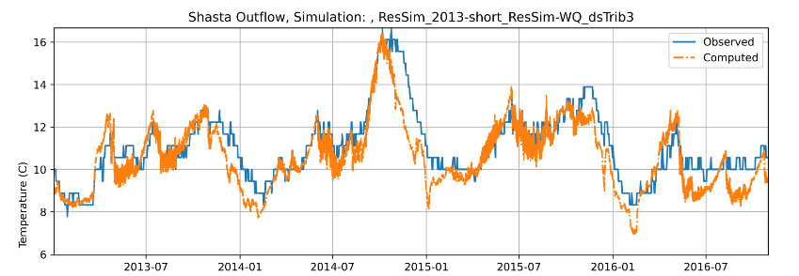
River Temperature and Cold-Water Pool Management with HEC-ResSim Upper Sacramento River, California Prepared by RMA for the U.S. Bureau of Reclamation (USBR)
Trinity Lake
Shasta Lake
Lewiston Dam
Shasta Temperature Control Device (TCD) graphic courtesy of Watercourse Engineering
Keswick Dam
Whiskeytown Lake

Slide 8
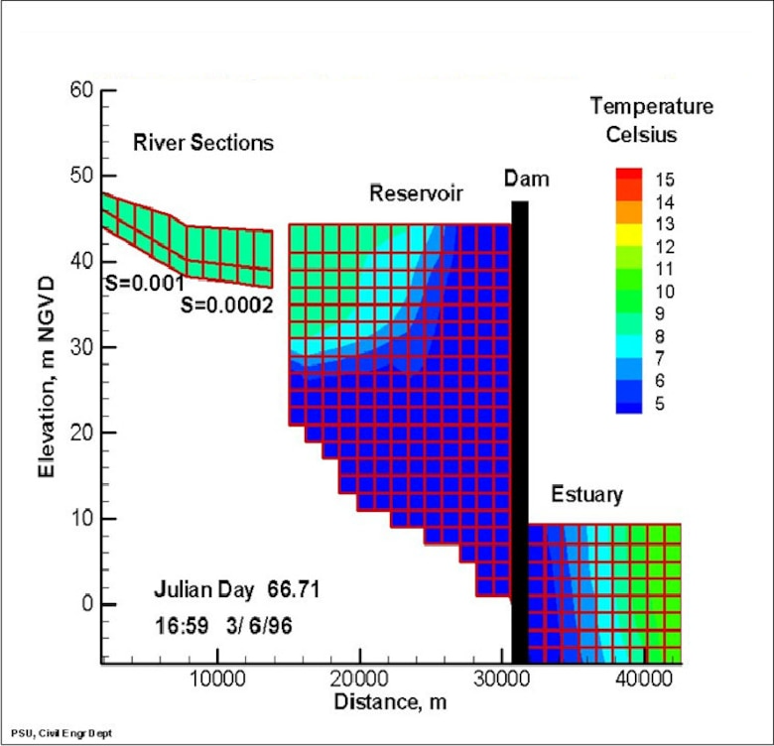
CE-QUAL-W2 Benefits
CE‐QUAL‐W2 simulates two‐dimensional (2D), longitudinal/vertical, hydrodynamics and water quality.
Enables characterization of the vertical and longitudinal changes in a reservoir.
Capable of resolving longitudinal gradients due to discharges, low residence time, etc.
Especially suited to long and narrow reservoirs that exhibit longitudinal and vertical water quality gradients. Longitudinal gradients may be caused by point source discharges or low residence time.
Widely used by USACE, USGS, USBR, and state and local agencies for environmental impact assessments, planning studies, etc.
Used as a research tool by researchers at universities and other organizations. Several thousand publications and reports have utilized or referenced CE-QUAL-W2.
“The number of publications that focused on water quality simulations using CE-QUAL-W2 ranked first most often, reaching 22 in 2020.” – Bai et al. (2022). Assessment and a review of research on surface water quality modeling. Ecological Modelling. https://doi.org/10.1016/j.ecolmodel.2022.109888
Open source and public domain. ERDC maintains the official version of the program. Users may freely edit the source code for custom applications.
Supported by the HH&C SET numerical model maintenance program
Longitudinal view of temperature output for a riverine section, reservoir, and estuary, from a CE‐QUAL‐W2 model application.

Slide 9
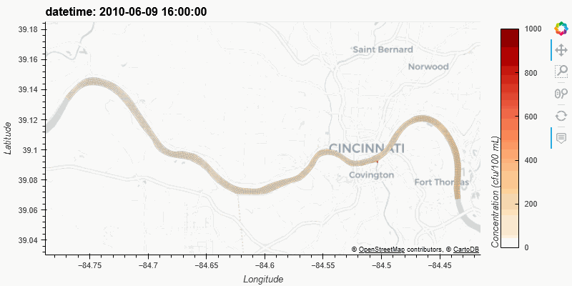
ClearWater-Riverine: Water Quality Modeling of Complex Channels and Floodplains with HEC-RAS-2D

Slide 10
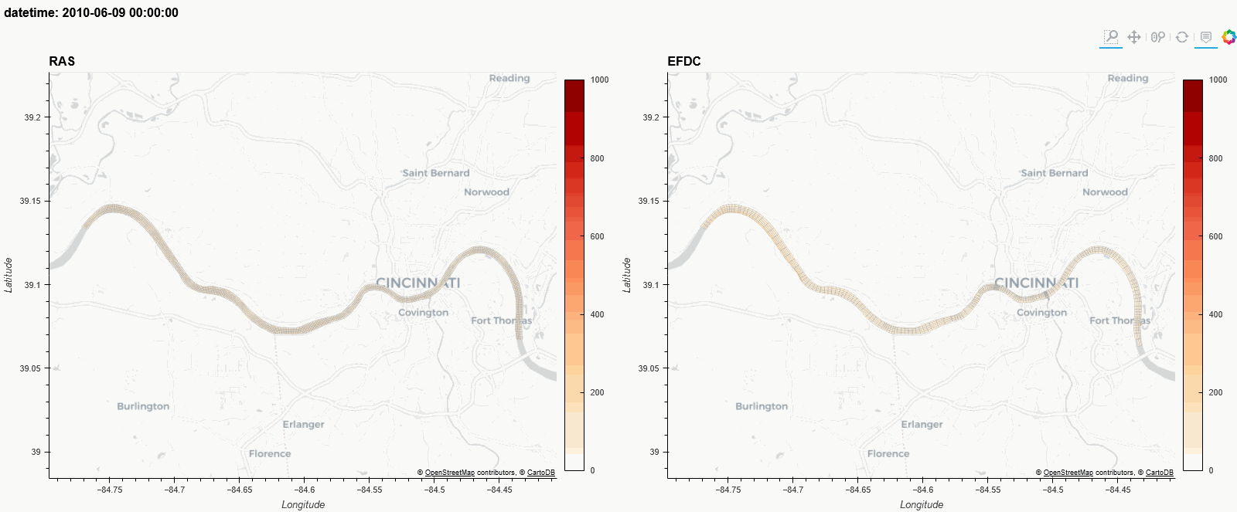
ClearWater-Riverine: Water Quality Modeling of Complex Channels and Floodplains with HEC-RAS-2D

Slide 11




Modern Scientific Python
Built using the cloud-native geospatial Python stack being widely adopted by NOAA, USGS, NASA, etc.
An object-oriented architecture inspired by xarray-simlab / fastscape and CSDMS LandLab
Automated unit testing
https://numfocus.org/sponsored-projects
Notes:
This [modern, cloud-native, geospatial Python] stack is designed to scale computations from a single set of values to multi-dimensional arrays, as shown in the icon for the xarray package, and scale from laptop to parallel computing to distributed cloud computing, powered by the Dask library that is built-in under-the-hood for xarray. All these libraries are very well supported by foundations, industry, and federal agencies.
We also wanted to follow modern numerical modeling coding patterns in widespread use by the geosciences community, so we we organized

Slide 12
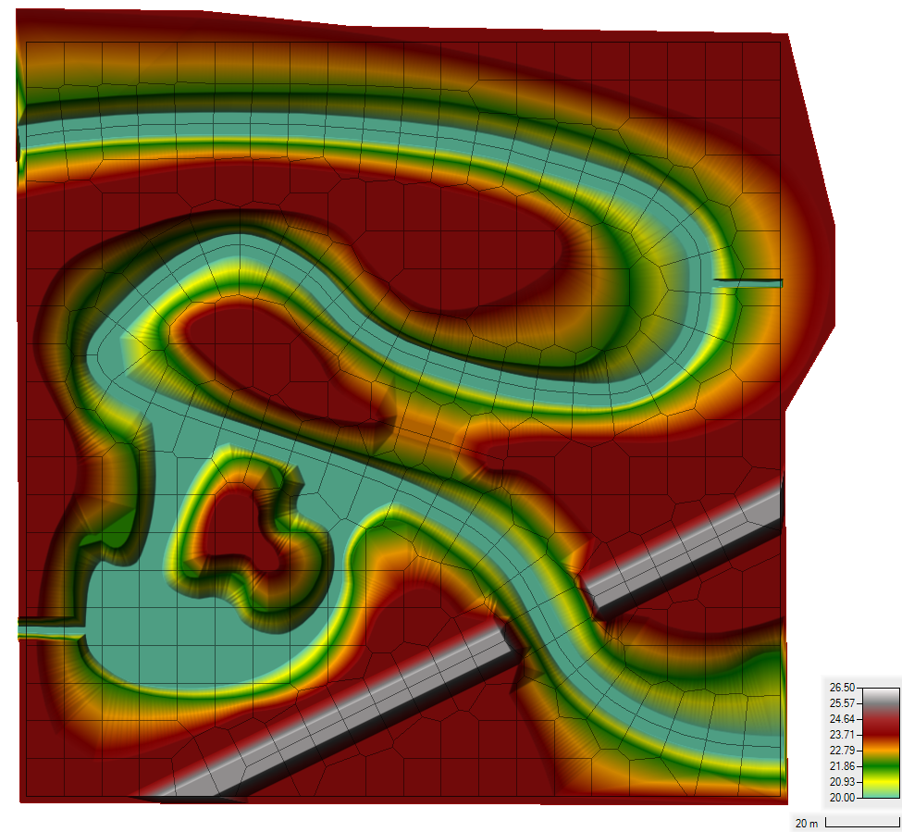
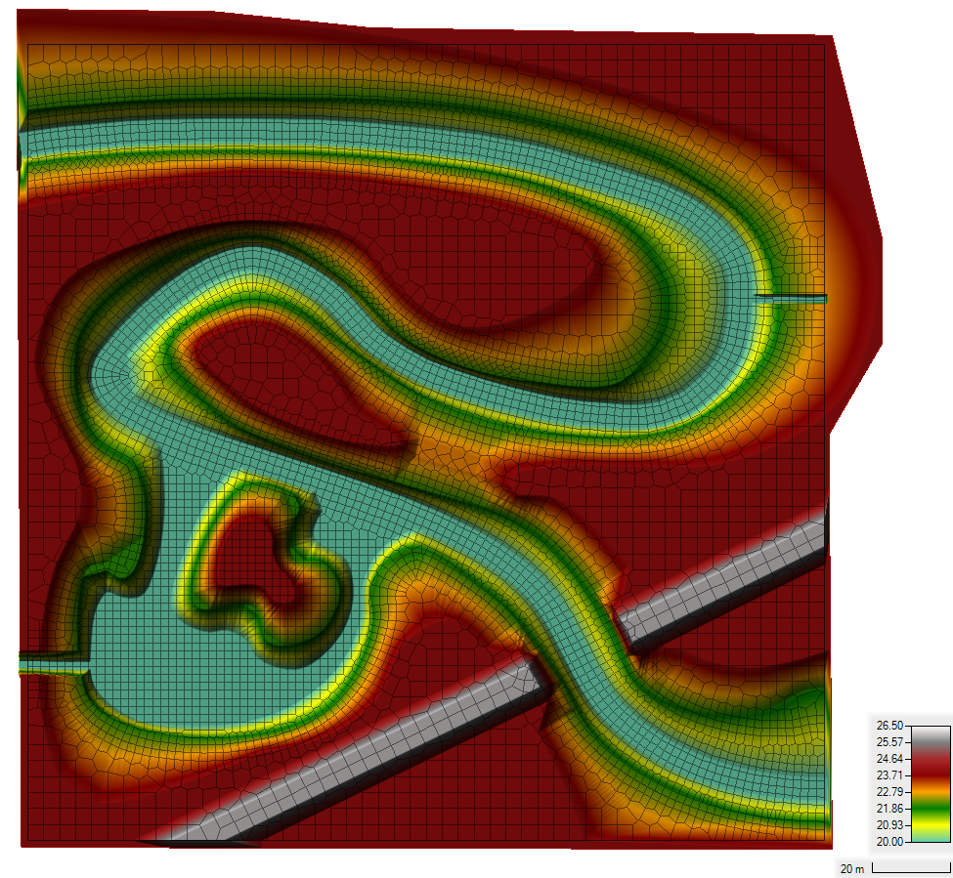
Demo Case Study: Sumwere Creek — Domain & Mesh
Coarse Mesh Fine Mesh
Notes:
Flow field is from HEC RAS-2D output in this case
Domain: 200 meters by 200 meters
Fictitious Topography/Bathymetry
- Bathymetry bottom elevation constant at 20 m
- Floodplain elevation constant at 24 m
- Roadway elevation constant at 26 m
Two Unstructured Meshes Tested
- Coarse Mesh: Base Mesh of 10 m by 10 m
- Fine Mesh: Base Mesh of 4 m by 4 m with a 2 m by 2 m refinement within the creek

Slide 13
Demo Case Study: Sumwere Creek — Domain, Mesh, and Hydrodynamic Boundary Conditions
Coarse Mesh Fine Mesh
Upstream: 3 cms
Spring:
1 cms
Powerplant:
0.5 cms
Downstream:
20.75 m
Notes:
HEC-RAS Boundary Conditions
- Upstream Flow for Sumwere Creek constant at 3 cms (1st hour ramping from zero)
- Downstream Stage for Sumwere Creek constant at 20.75 m
- Flow for Cold Spring Creek constant at 1 cms (1st hour ramping from zero)
- Flow for Power Plant Chute constant at 0.5 cms (1st hour ramping from zero)

Slide 14
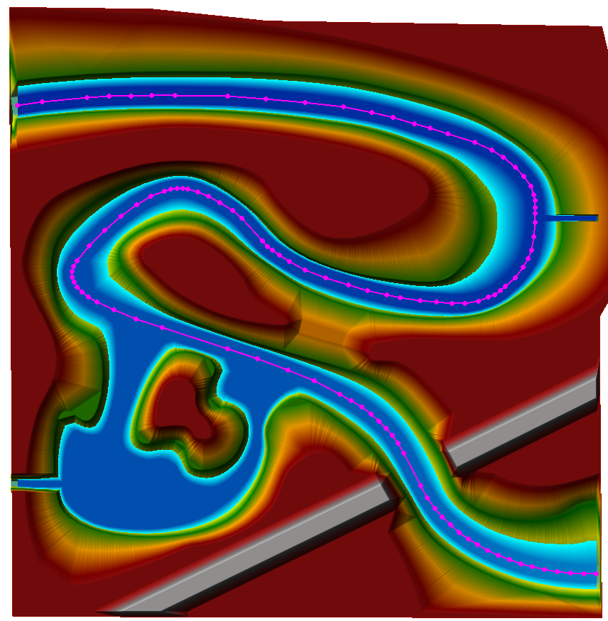
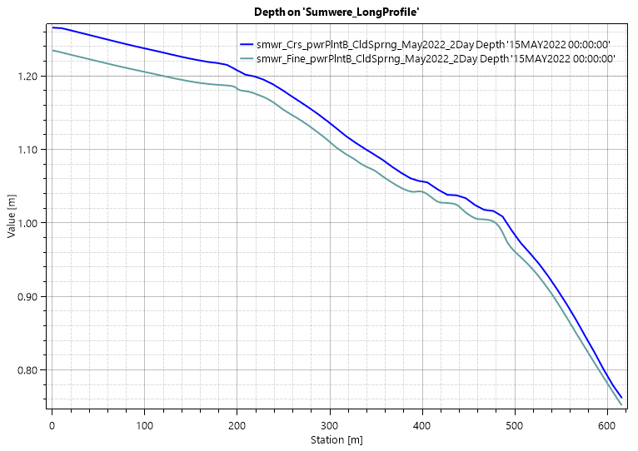
Demo Case Study: Sumwere Creek — Depth at End of Simulation
Notes:
Profile of the coarse and fine mesh depth results along the magenta line in the plan view plot.
This shows the depth at the upstream boundary at 1.27 m and 1.23 for the coarse and fine mesh, respectively (4 cm difference); these depth difference are due to mesh resolution. This shows approximately 0.5 m of hydraulic head is required to overcome the bed friction for this flow rate. A uniform Manning’s roughness coefficient of 0.06 was used in both meshes.

Slide 15
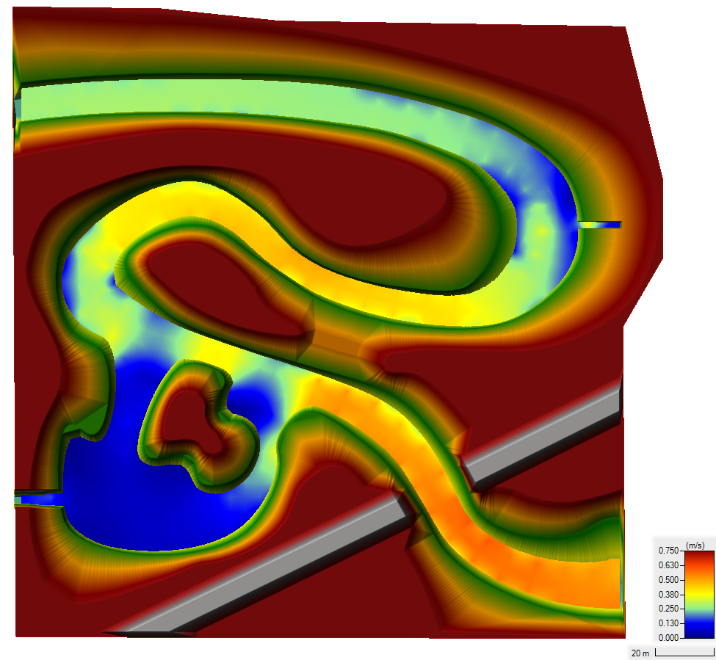
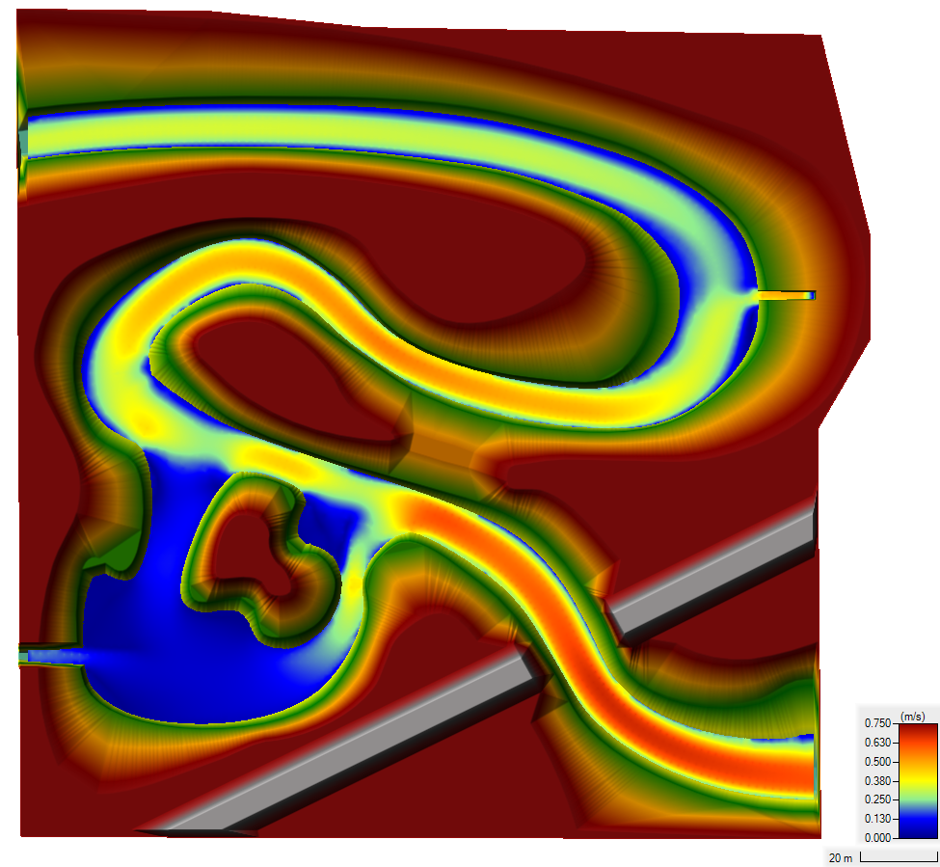
Demo Case Study: Sumwere Creek — Velocity at End of Simulation
Coarse Mesh Fine Mesh
Notes:
Differences in velocities between the meshes are due to varying spatial resolution in each mesh

Slide 16
Demo Case Study: Sumwere Creek — Temperature Boundary Conditions
Coarse Mesh Fine Mesh
Upstream: 15˚C
Spring:
5˚C
Powerplant:
20-25 ˚C
Notes:
Boundary conditions are the same for both the coarse and the fine mesh.
Designed to show longitudinal mixing across the river
Exploration of different extremes (cool water from spring-fed tributary versus warm water from powerplant)

Slide 17
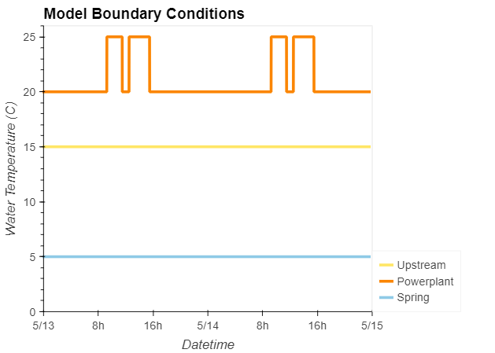
Demo Case Study: Sumwere Creek — Temperature Boundary Timeseries
Coarse Mesh
Upstream: 15˚C
Spring:
5˚C
Powerplant:
20-25 ˚C
Notes:
Timeseries of boundary conditions (stable, except for powerplant discharge)
Powerplant discharge has two peaks during the day (one in the morning, one in the afternoon)

Slide 18
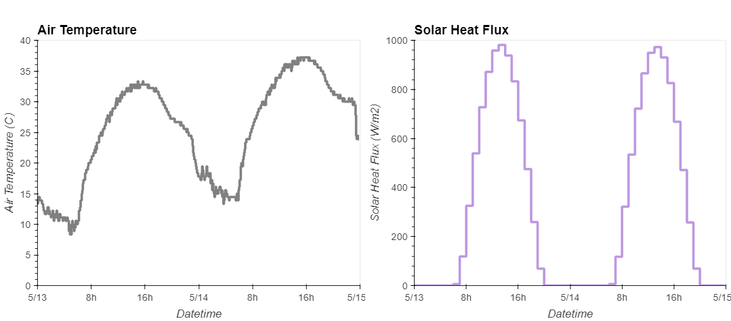
Demo Case Study: Sumwere Creek — Meteorological Timeseries
Notes:
Meteorological timeseries used as inputs to TSM.
Air temperature and solar heat flux both peak during the day and drop at night.
Timeseries from Arizona (extreme cycles to help capture impact of TSM).

Slide 19
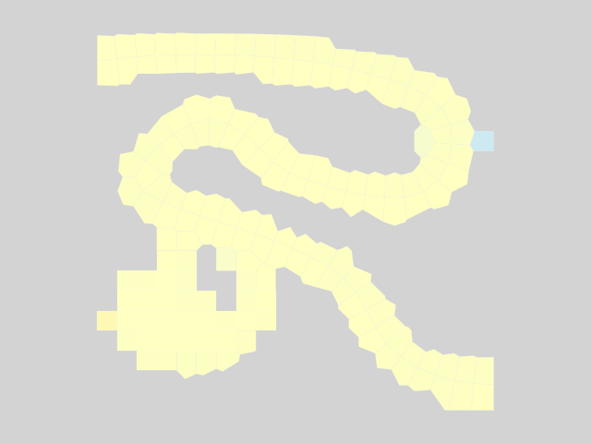
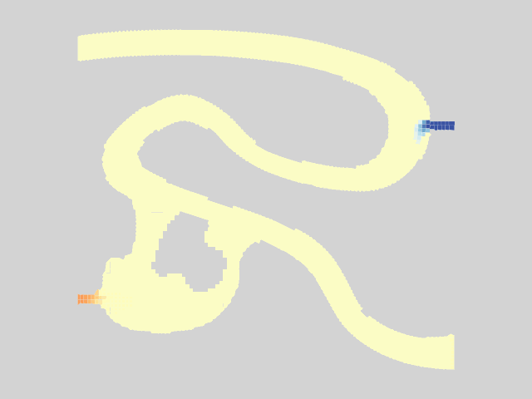



Results – Animation
Coarse Mesh Fine Mesh
Notes:
You can see the mixing.
Ultimately reaches steady state.

Slide 20



Results – Warm Powerplant Inflows
Coarse Mesh Fine Mesh
Notes:
Pulses from powerplant.
Can see a lot more transverse mixing from the powerplant and spring in the fine mesh compared to the coarse mesh.
Can see more detail on the plume of warm water.
This all shows transport very clearly, but what about our energy budget model / TSM?

Slide 21



ClearWater Framework Summary
ClearWater’s Python-based framework allows easy integration with powerful interactive visualization packages
Enhanced understanding of complex environmental/ecological outcomes
Iterative analysis and scenario discovery
Multidimensional exploration across time and space
Effective communication of results across teams and stakeholders
Notes:
Building on the shoulders of giants.
We do not build or maintain any of these libraries.

Slide 22

Water quality processes team
Over-riding objective:
Transform data to actionable information

Slide 23


Water quality processes team
Recent project topics:
Operational control dashboard for HABs
Historic water quality data analysis
Retrospective water quality data review
Post-wildfire water quality and ecology
Large scale nutrient transport in river systems
Networked riverine contaminant model
Fate and Risk Evaluation System for Contaminants
Global GIS for environmental terrain
New models for new data sources

Slide 24


Water quality processes team
Recent project topics:
Operational control dashboard for HABs
Historic water quality data analysis
Retrospective water quality data review
Post-wildfire water quality and ecology
Large scale nutrient transport in river systems
Networked riverine contaminant model
Fate and Risk Evaluation System for Contaminants
Global GIS for environmental terrain
Adding functionality to the archive

Slide 25



Water quality processes team
Recent project topics:
Operational control dashboard for HABs
Historic water quality data analysis
Retrospective water quality data review
Post-wildfire water quality and ecology
Large scale nutrient transport in river systems
Networked riverine contaminant model
Fate and Risk Evaluation System for Contaminants
Global GIS for environmental terrain
Standing back from operations to observe
long term patterns and trends

Slide 26



Water quality processes team
Recent project topics:
Operational control dashboard for HABs
Historic water quality data analysis
Retrospective water quality data review
Post-wildfire water quality and ecology
Large scale nutrient transport in river systems
Networked riverine contaminant model
Fate and Risk Evaluation System for Contaminants
Global GIS for environmental terrain
Untangling long- and short- term change
Gage 179 Pre- and Post- Fire Temps
Upper limit Chinook spawning
Upper limit Chinook egg viability
0 5 10 15
Temp, Deg-C
Upper limit Chinook alevin development
Week

Slide 27

Water quality processes team
Recent project topics:
Operational control dashboard for HABs
Historic water quality data analysis
Retrospective water quality data review
Post-wildfire water quality and ecology
Large scale nutrient transport in river systems
Networked riverine contaminant model
Fate and Risk Evaluation System for Contaminants
Global GIS for environmental terrain
Matching data to purpose

Slide 28





Water quality processes team
Recent project topics:
Operational control dashboard for HABs
Historic water quality data analysis
Retrospective water quality data review
Post-wildfire water quality and ecology
Large scale nutrient transport in river systems
Networked riverine contaminant model
Multimedia contaminant screening system
Global GIS for environmental terrain
Model and data systems built for science, not sensors
Contaminants:
Metals
Munitions
PFAS
Pesticides and toxins
Rare Earth Elements

Slide 29

















Team up on Water Quality and Contaminant Modeling Solutions
Programs and partners
USACE-ERDC-EL-EPW
Water Quality and Contaminant Modeling
Jodi L. Ryder
Jodi.L.Ryder@usace.army.mil
601-631-1852
Todd E. Steissberg
Todd.E.Steissberg@usace.army.mil
530-574-5572
Aaron C. Urbanczyk
Acting Chief EPW
Aaron.C.Urbanczyk@usace.army.mil
601-634-7408

